Slide 1
Online Final Semester Examinations September 2020 BHARATHIAR UNIVERSITY, COIMBATORE – 641 046
Instructions to the Students for Attending Online Examinations

Slide 2
DOs
Make sure that the student should have good internet connectivity and power.
Keep your browser (Google chrome, Mozilla Firefox, Microsoft Edge…) with latest version.
Keep your device (PC, Laptop, Smart mobile) with device time zone as (UTC + 05:30) Chennai, Kolkatta, Mumbai, Newdelhi.
Timings to be followed:
Login to the portal : @ 09.30am
Question paper to be download : @ 09.45am
Answer scripts to be uploaded : @ 01:30pm

Slide 3
DOs
Use only A4 sheets to write your examination.
The Online Examination portal will be closed automatically at 01.40pm.
If there is any issues during login, downloading the question paper, uploading the answer scripts, you are requested to contact your college Principal office/Head of the department for further process immediately.
The login name and password created during mock test should be used during the online semester examinations.

Slide 4
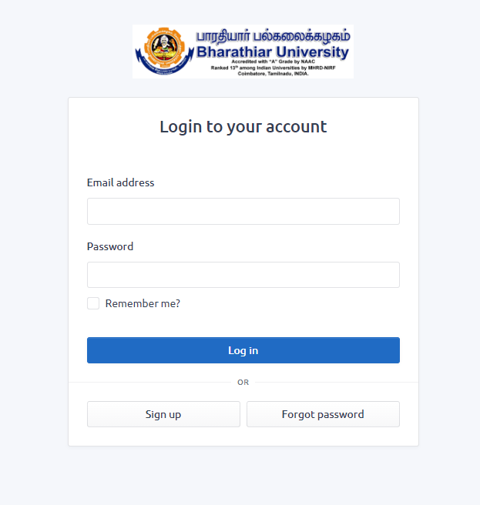
STUDENT PAGE - PROCESS FLOW
Step 1: New User Registration: Click Sign up button

Slide 5
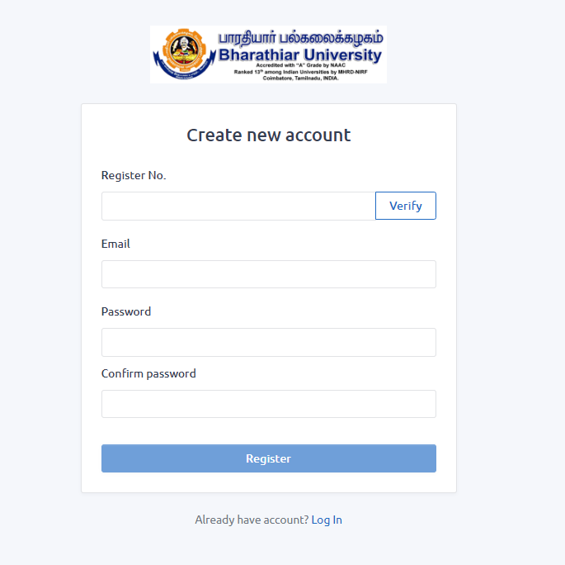
Step 2: New User Registration Page as below.

Slide 6
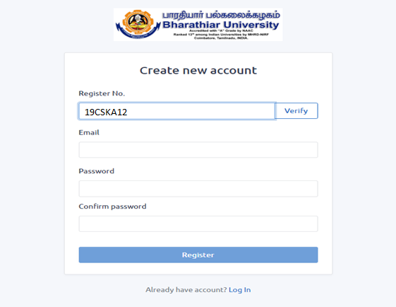
Step 3: Enter the Register Number and Click verify button to check whether the candidate has registered for the examination.

Slide 7
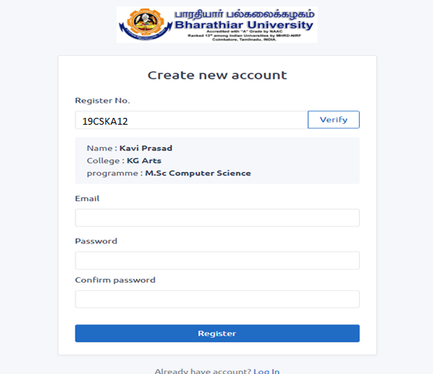
Step 4: If the student entered correct register number, the below page will be displayed.

Slide 8
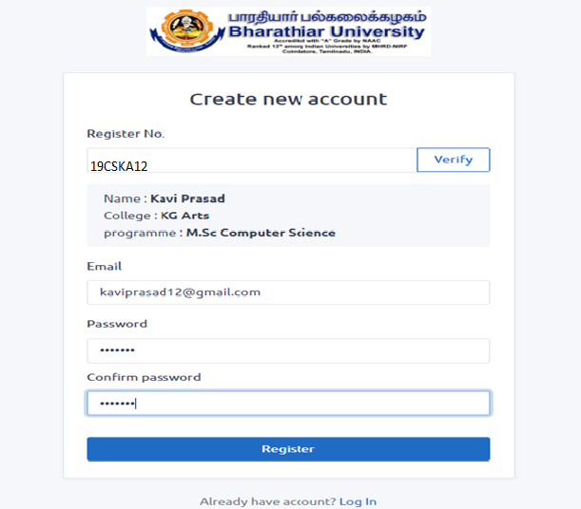
Step 5: Enter the valid email id and type a new password and confirm password in the new user registration form and click Register button.

Slide 9
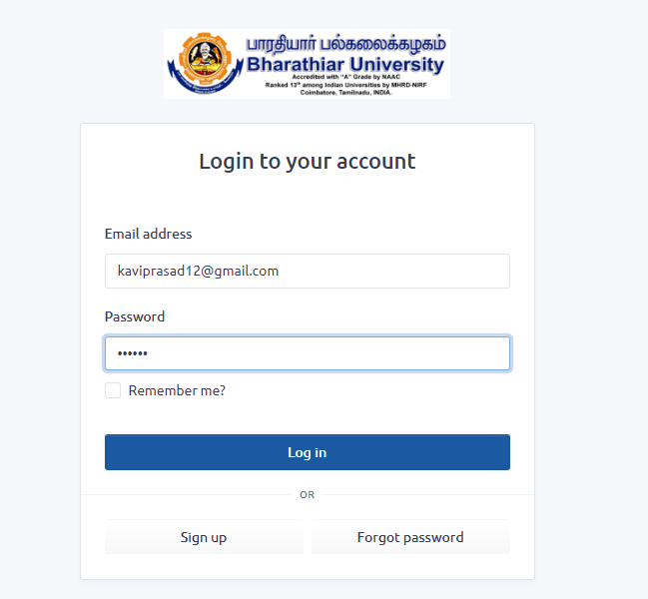
Step 6: After the successful registration, the user get into the Online examinations portal by giving the email id and password.

Slide 10
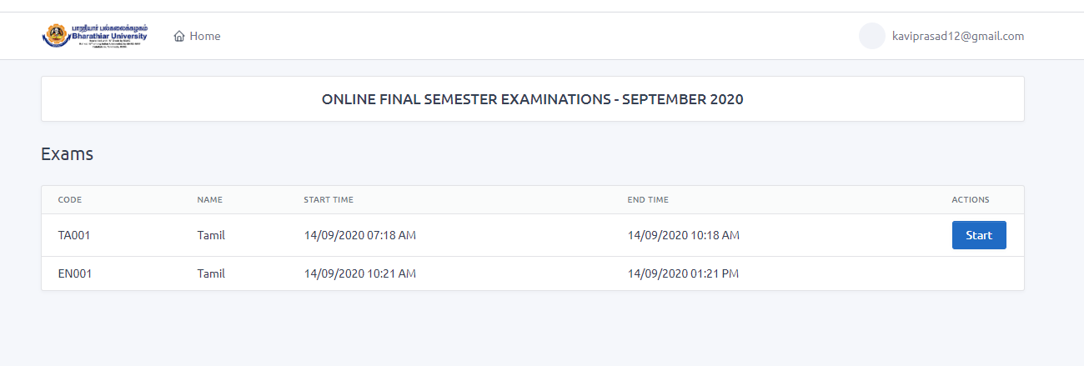
Step 7: The list of papers to be displayed with subject code, subject name, start time, end time of examination and start option as shown in below screen shot. Click the Start button in Actions.

Slide 11
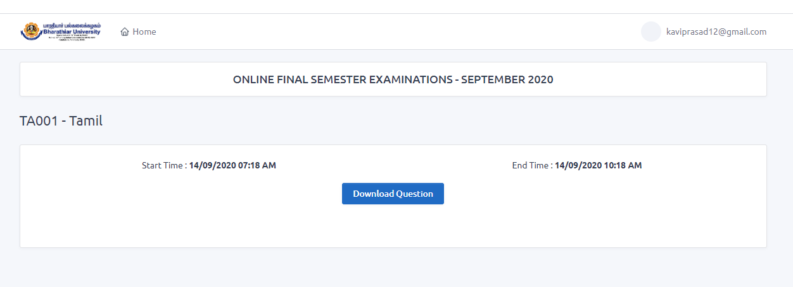
Step 8: The question paper to be downloaded by clicking download question button.

Slide 12
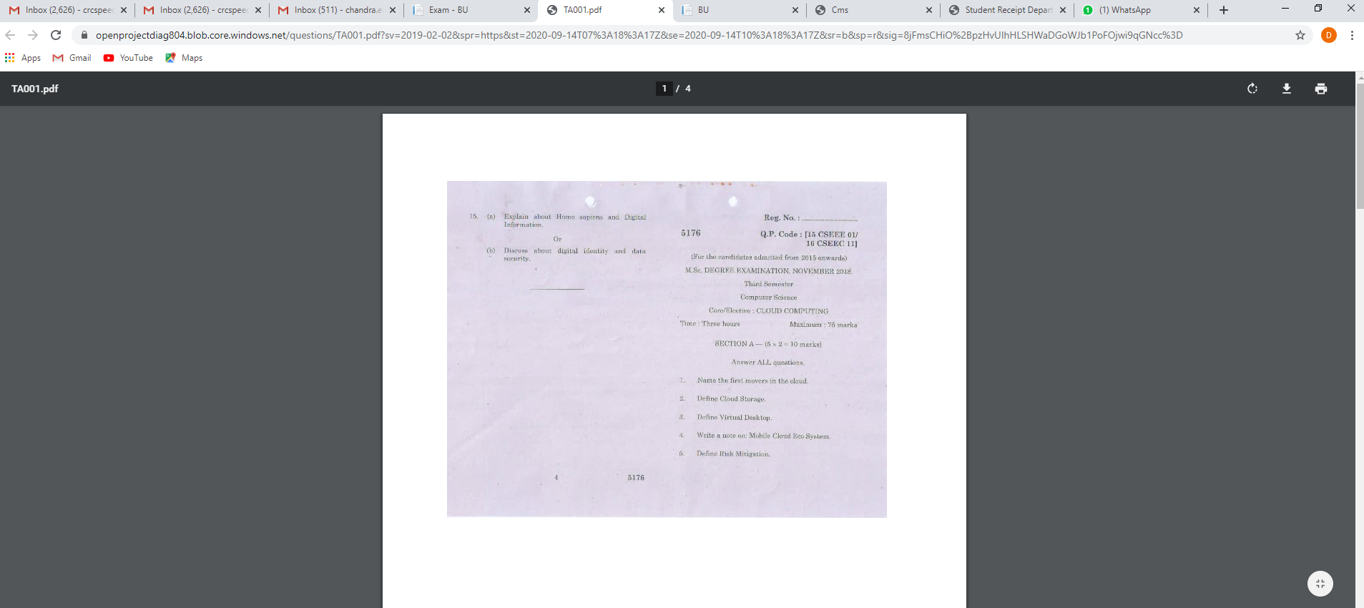
Step 9: The question paper is displayed as shown below in a new tab.

Slide 13
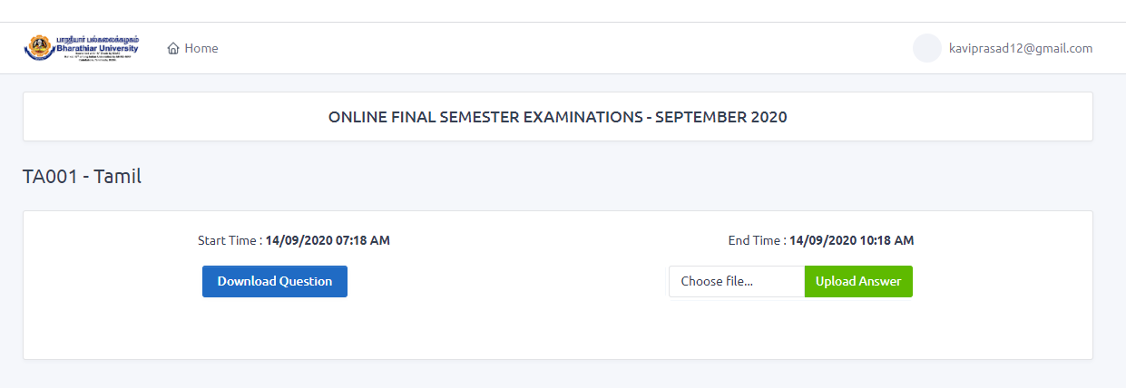
Step 10: Attend the Examination – Write the examination in the A4 sheets, every page should be properly numbered without fail.
Step 11: Capture all the pages of answer scripts in JPEG file format via mobile camera.
Step 12: All the captured pages to be uploaded in the portal by clicking the Upload Answer button as shown in the below screen shot.

Slide 14
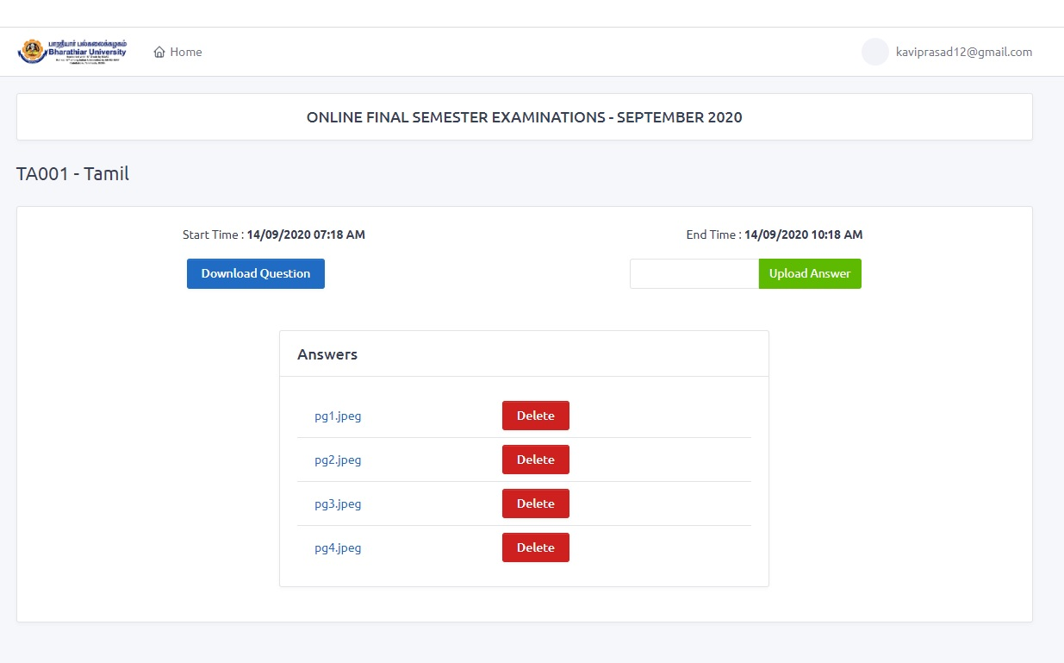

Slide 15
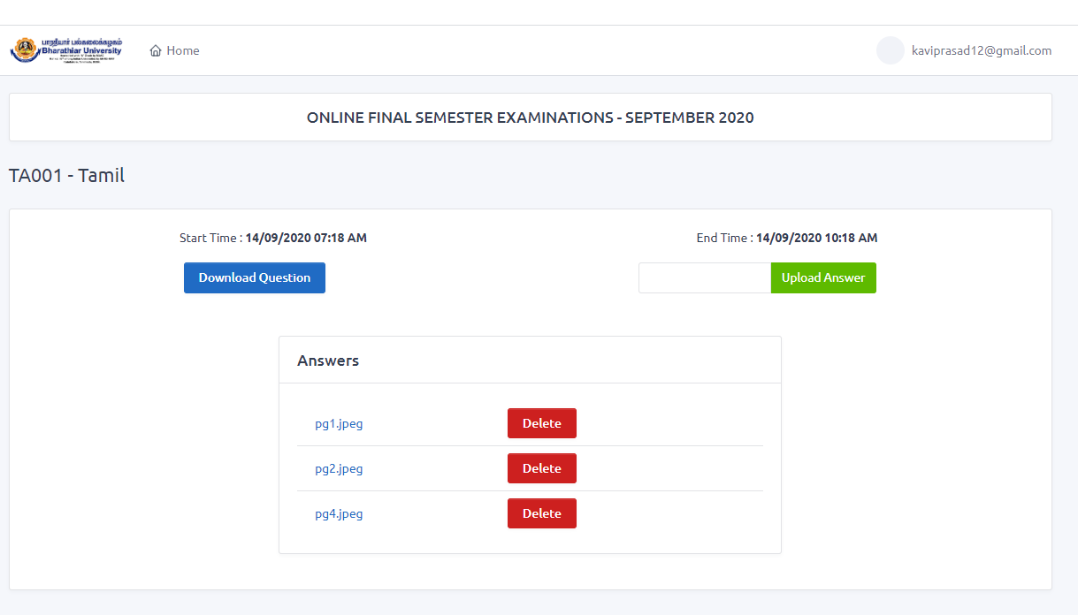
Step 13: The Delete button may be used to delete the wrong images uploaded if any. For example, the below screen shot shows only 3 jpeg files after deleting pg3.jpeg image.

Slide 16
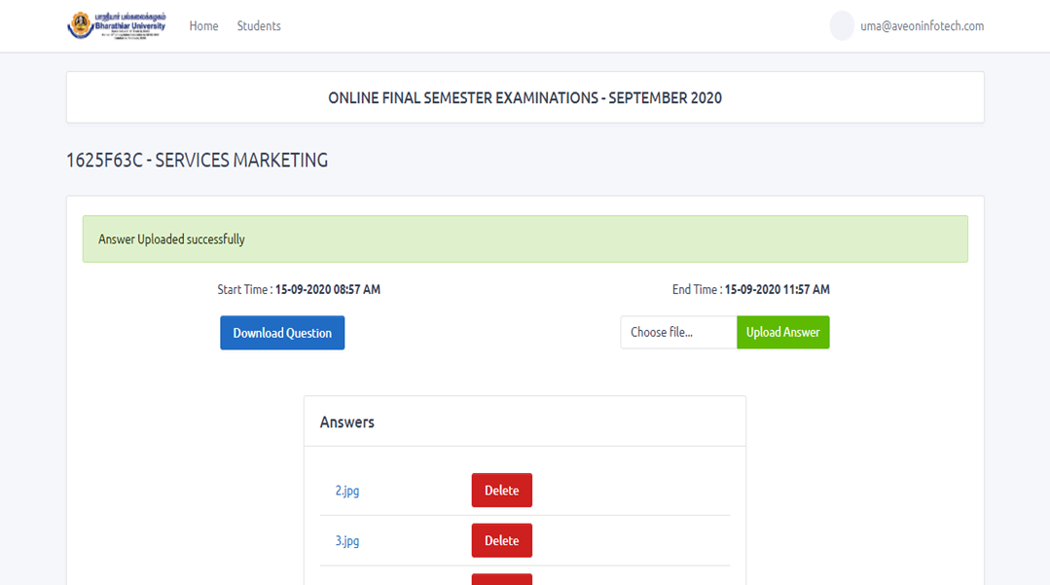
Step 13: The Delete button may be used to delete the wrong images uploaded if any. For example, the below screen shot shows only 3 jpeg files after deleting pg3.jpeg image.

Slide 17
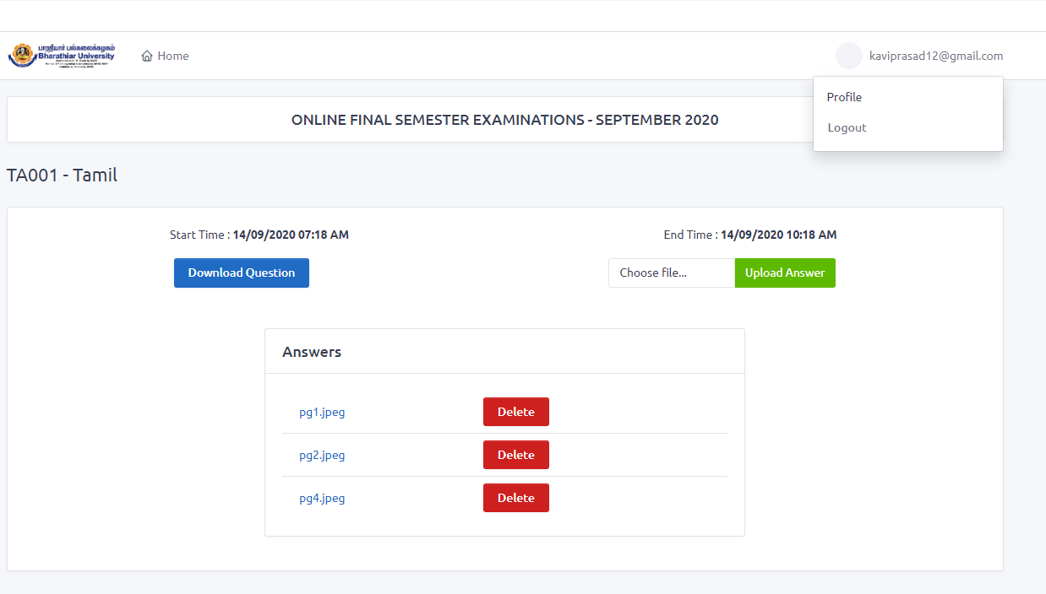
Step 14: After uploading all the pages, logout the online examinations portal by clicking logout.

Slide 18
Thank you all

